Slide 1
Hoot - Extending Istio with the EnvoyFilter CRD
Scott Weiss
Architect – Solo.io

Slide 2
Istio provides the following OOTB:
Service discovery / Load balancing
Secure service-to-service communication (mTLS)
Traffic control / shaping / shifting
Policy / Intention based access control
Traffic metric collection

Slide 3
Istio provides the following OOTB:
Service discovery / Load balancing
Secure service-to-service communication (mTLS)
Traffic control / shaping / shifting
Policy / Intention based access control
Traffic metric collection
ServiceEntry + DestinationRule
DestinationRule
VirtualService
AuthorizationPolicy
(built in)

Slide 4
Istio does not provide OOTB:
Cross-cluster Networking
External Auth / Rate Limiting
Traffic Failover
WAMS Filters
Access Logging / many unexposed Envoy features
EnvoyFilter + ServiceEntry + Gateway
EnvoyFilter
EnvoyFilter
EnvoyFilter
EnvoyFilter + ?

Slide 5
What is the EnvoyFilter?
Swiss Army Knife of customizing Istio Proxy (Envoy) configuration
For when native Istio CRDs (VirtualService, DestinationRule) do not provide enough control over Envoy config

Slide 6
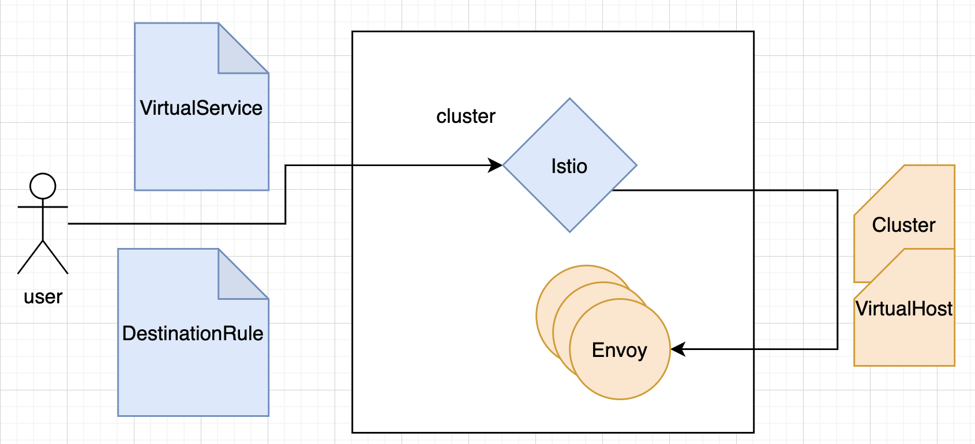
Istio -> Envoy Config Architecture
Istio can be understood as a translation engine, translating high-level Istio CRDs into low-level Envoy config resources.

Slide 7
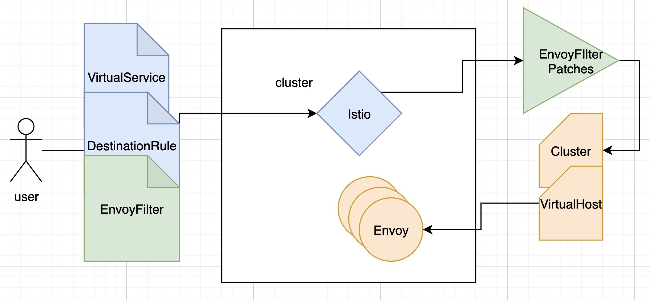
Istio -> Envoy Config Architecture + EnvoyFilter
The EnvoyFilter CRD exposes an opaque Patching mechanism for customizing Envoy configuration beyond what Istio exposes natively.

Slide 8
Istio -> Envoy Config Example
{
"name": "reviews-v2-routes",
"match": {
"prefix": "/",
"caseSensitive": true
},
"route": {
"cluster": "outbound|80|v2|reviews.bookinfo.svc.cluster.local",
...
}
}
apiVersion: networking.istio.io/v1alpha3
kind: VirtualService
metadata:
name: reviews-route
namespace: bookinfo
spec:
hosts:
- reviews.bookinfo.svc.cluster.local
http:
- name: "reviews-v2-routes"
match:
- uri:
prefix: "/"
route:
- destination:
host: reviews.bookinfo.svc.cluster.local
subset: v2

Slide 9
Istio -> Envoy Config Example + EnvoyFilter
# auth example
apiVersion: networking.istio.io/v1alpha3
kind: EnvoyFilter
metadata:
name: reviews-external-auth
namespace: istio-system
spec:
configPatches:
- applyTo: HTTP_ROUTE
match :
context: SIDECAR_OUTBOUND
vhost:
route:
name: "reviews-v2-routes"
action: "ROUTE"
patch:
operation: MERGE
value:
route:
typed_per_filter_config:
envoy.ext_authz:
'@type': type.googleapis.com/envoy.config.filter.http.ext_authz.v2.ExtAuthzPerRoute
check_settings:
context_extensions:
config_id: custom-ext-auth

Slide 10
Istio -> Envoy Config Example + EnvoyFilter
{
"name": "reviews-v2-routes",
"match": {
"prefix": "/",
"caseSensitive": true
},
"route": {
"cluster": "outbound|80|v2|reviews.bookinfo.svc.cluster.local",
},
"typedPerFilterConfig": {
"envoy.ext_authz": {
"@type": "type.googleapis.com/envoy.config.filter.http.ext_authz.v2.ExtAuthzPerRoute",
"checkSettings": {
"contextExtensions": {
"config_id": "default.dev"
}
}
}
}
...
}
apiVersion: networking.istio.io/v1alpha3
kind: VirtualService
metadata:
name: reviews-route
namespace: bookinfo
spec:
...
apiVersion: networking.istio.io/v1alpha3
kind: EnvoyFilter
metadata:
name: reviews-external-auth
namespace: bookinfo
spec:
...

Slide 11
Istio -> Envoy Config Demo

